Slide 1

Marketing Campaign Performance
Rohit Deshpande

Slide 2
Overview
In this Excel project, we will analyze the performance based on the market data to gain insights into different aspects over marketing channel over the years. The dataset used in this project will contain information on Marketing channel, conversion rate, campaign names and other relevant matrices.

Slide 3
Objective
The objective of this Excel project is to Marketing campaign performance data to gain valuable insights into various aspects of marketing performance over different countries. The primary goal is to provide a comprehensive and data-driven view market performance, its relationships, and identify key patterns. The analysis aims to answer critical questions and support decision-making in the field of marketing.

Slide 4
Key learnings : This project was a hands-on learning experience that enhanced my Excel skills and analytical abilities. I gained proficiency in using Excel tool to explore and analyze large datasets, extract relevant information, and draw valuable insights.
Data source: We will use the dataset that includes the marketing campaign performance table.
Key Columns:
Campaign Name: Contains the different names of campaigns.
Start date & End date
Marketing Channel: There are different channels.
CTR: It contains the Click through rate
Conversion rate:
ROI: Return on investment.
customers demographics: The age group of customers.

Slide 5

Project Steps:
Data Loading:
Data is in CSV Format. Imported the database into Excel.
Data Transformation:
Performed data cleaning and transformation which includes removing null values, removing errors, removing duplicates, checking for data types.
Data Modelling:
There are 1 Fact Table marketing campaign performance.

Slide 6
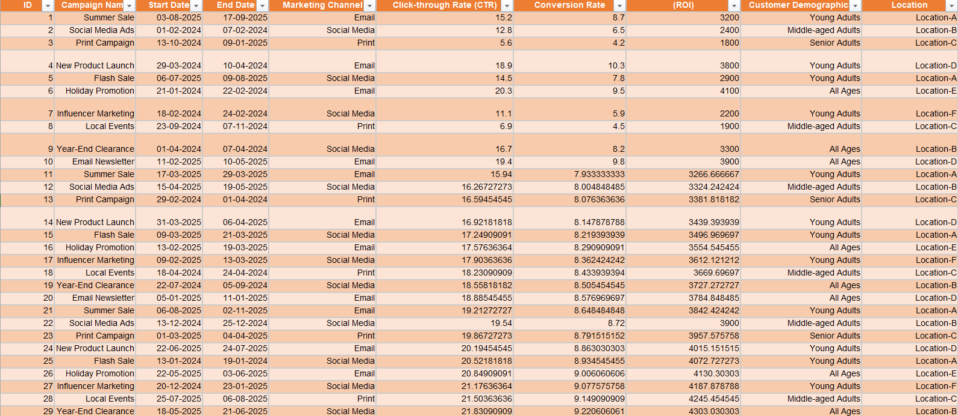
Marketing Channel Performance Dataset

Slide 7

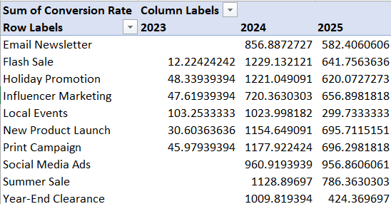
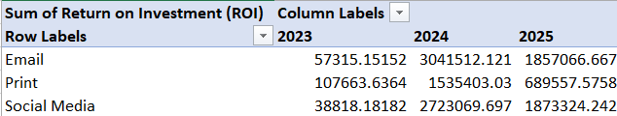
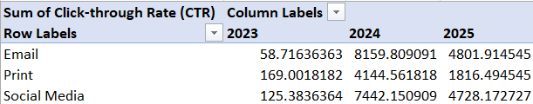
The pivot tables for visualization

Slide 8
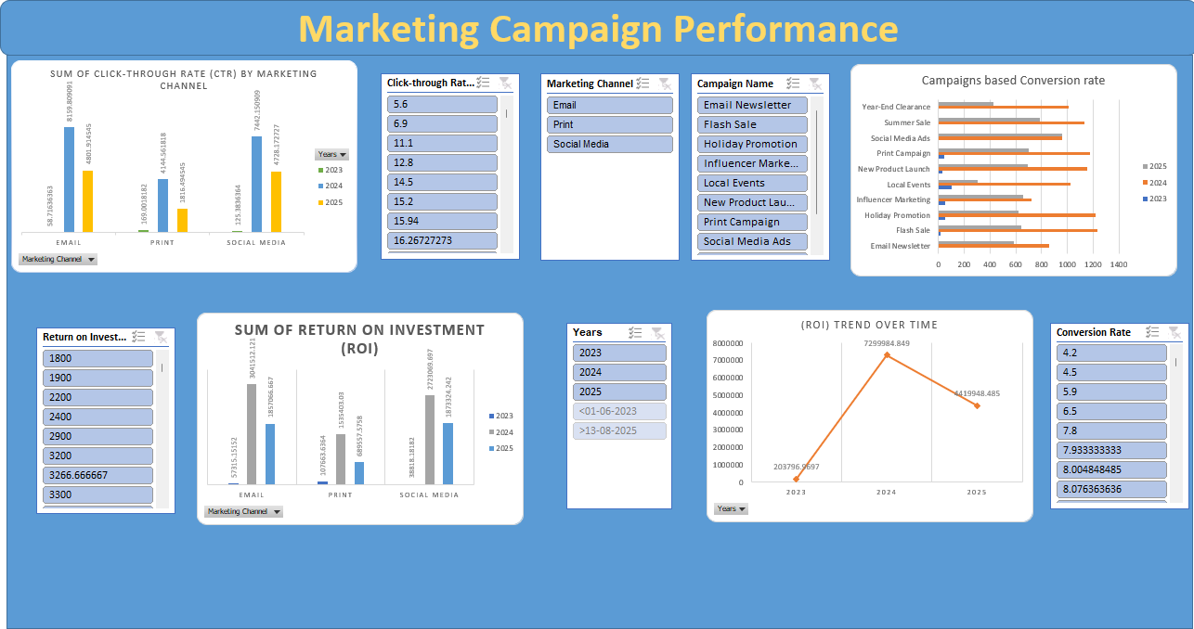
Data Visualization

Slide 9
Insights
Click trough rate(CTR) by marketing channel: There are three marketing channels Email, Print, Social media and it organized by year wise. The CTR of all three channels is highest in year 2024 and the lowest in 2025.
Return on investment(ROI): For the Three marketing channel and year wise ROI is same as CTR.
Campaign Based Conversion rate: The conversion rate of summer sale, Print campaign, Flash sale and other matrices is highest for year 2024 and lowest for year 2025. And for some of the channels there is no conversion rate.
(ROI) Trend over time: The ROI trend for year 2023 is 203796.9697 and in 2024 it is increased at 7299984.849 and for 2025 in slightly decrease at 4419948.485. There is trend that constantly increasing and decreasing per year.
Recommendation: Click through rate(CTR), Return on investment(ROI), Campaign based conversion rate and ROI trend over time is high 2024 and decreasing in 2025 so the marketing channels should focus to increase the above thing over time.
Conclusion: I thoroughly enjoyed working on this Marketing Campaign Performance project. It provided a valuable opportunity to apply Excel skill to real world data to gain insights into marketing industry

